Slide 1



CATCH THE AI
AI GENERATED MEDIA DETECTION

Slide 2
Project Team
Romani Nasrat Shawqi .
Ahmed Mohamed Ali.
Zeyad Elsayed Abdel-Azim.
Sara Reda Moatamed.
Reham Moustafa Ali.
Rawan Abdel-Aziz Ahmed.
Abdallah Mohammed Abdel-monnem.
Mohannad Ayman salah.
Mohammed Abdallah Abdel-salam.
Under Supervision :
Dr. Eman Abdel-Latef .
Eng. Sahar Mohamed.

Slide 3






Agenda
Problem Statement.
Existing Techniques.
Gap in scientific scene.
Methodology with implementation and evaluation.
Discussion.
Conclusion.

Slide 4
Problem Statement.
Existing Techniques.
Gap in scientific scene.
Gap in scientific scene.
Methodology with implementation and evaluation.
Discussion.
Conclusion.

Slide 5
Problem Statemnt.
Existing Techniques.
Methodology with implementation and evaluation
Gap in scientific scene.
Gap in scientific scene.
Methodology with implementation and evaluation.
Discussion.
Conclusion.

Slide 6
Existing Techniques.
Gap in scientific scene.
Methodology with implementation and evaluation
Discussion.
Conclusion.

Slide 7
Gap in scientific scene.
Methodology with implementation and evaluation
Utilizing advanced algorithms, the system identifies subtle manipulations indicative of AI generation. Three primary detection models form the core of this system and were worked on in parallel :
AI Image Generation Detection: Accurately identifies images created by artificial intelligence.
AI Text Generation Detection: Recognizes text authored by AI algorithms and distinguishes it from human-generated content.
AI-Generated Audio Detection: Identifies and differentiates between audio content generated by artificial intelligence and authentic human-recorded audio.
Then we started working on Building the system.
Discussion.
Conclusion.

Slide 8

System Overview
Methodology with implementation and evaluation
FRONT
BACK

Slide 9
Methodology with implementation and evaluation
4.1 FRONT.
i.Step one

Slide 10
1.Front.
Methodology with implementation and evaluation
i.Step one
ii.Step two

Slide 11
System Overview
Methodology with implementation and evaluation
FRONT
BACK

Slide 12
Methodology with implementation and evaluation
4.2 Back.
i.Step one

Slide 13
2.Back.
Methodology with implementation and evaluation
i.Step one
ii.Step two

Slide 14
i.Step one
2.Back.
Methodology with implementation and evaluation
ii.Step two
iii.Step 3

Slide 15

Models Selection
Methodology with implementation and evaluation
Audio Model
Text Model
Image Model

Slide 16
Methodology with implementation and evaluation
4.1 Audio Detector :
i.Step one

Slide 17
1.Audio Detector.
Methodology with implementation and evaluation
i.Step one
ii.Step two

Slide 18
i.Step one
1. Audio Detector.
Methodology with implementation and evaluation
ii.Step two
iii.Step 3

Slide 19
Models Selection
Methodology with implementation and evaluation
Audio Model
Text Model
Image Model

Slide 20
Methodology with implementation and evaluation
4.2 Text Detector :
Our journey to reach the final result was divided into 3 steps:
Build Model from scratch.
Go to Pre-train Models (Mistral 7B & BERT).
Final model (RoBERTa & DeBERTa).

Slide 21
i.Step one : Build Model from scratch
2 .Text Detector .
Methodology with implementation and evaluation
i.Build Model from scratch
Data acquisition:
Data was collected from HuggingFace and Kaggle :
LLM - Detect AI Generated Text.(1378)
DAIGT | All data For Model:
We created Dataset to combine all the different data that we found on Kaggle and Huggingface to make it easier for us to use it and apply preprocessing to it , to reach about 273,715 thousand and to make balance data we use 263,718 .
Data preprocessing:
Removed unwanted characters like carriage returns and URLs, cleans up hashtags and special characters, reduces multiple spaces to a single space, and converts text to lowercase if needed.
Tokenization:
Use tokenizer from Keras and ELMo to Embedding .
Use pre-trained BERT Tokenizer and Embedding from Transformer library.
Length sequence 512.
ii. Go to Pre-train Models

Slide 22
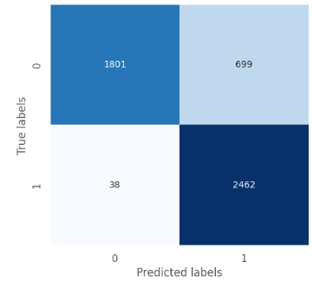
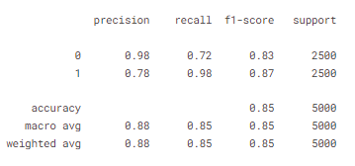
i.Step one : Build Model from scratch
2 .Text Detector .
Methodology with implementation and evaluation
i.Build Model from scratch
Model Architecture :
Use Bi-LSTM to allows the model to capture context and understand sentence from both directions.
use convolutional layer that operates on sequential data with one spatial dimension to increase complexity.
ii. Go to Pre-train Models

Slide 23
i.Step one : Build Model from scratch
2 .Text Detector .
Methodology with implementation and evaluation
ii. Go to Pre-train Models
Data Preparation:
We only used the data collected from Kaggle, which was about 32,462 data.
We used the data as it is, without cleaning , because we believe that these symbols are considered a feature for text detection.
Model Architecture:
Mistral 7B is a robust and efficient model for classification tasks, offering a compelling combination of performance, adaptability, and cost-effectiveness. Its ability to handle complex text understanding .
iii.Final model

Slide 24
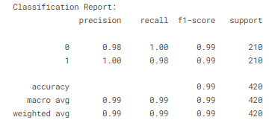
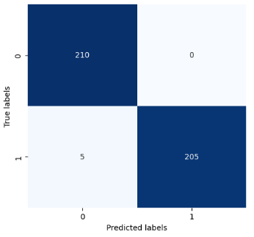
i.Step one : Build Model from scratch
2 .Text Detector .
Methodology with implementation and evaluation
ii. Go to Pre-train Models
Challenges:
Model Size:
Memory Consumption.
Storage Requirements
Computational Time:
Training Time.
Inference Time.
iii.Final model

Slide 25
ii.Step two
2 .Text Detector .
Methodology with implementation and evaluation
iii.Final model

Slide 26
Models Selection
Methodology with implementation and evaluation
Audio Model
Text Model
Image Model

Slide 27
Methodology with implementation and evaluation
4.1 Image generated detector .
i.Step one

Slide 28
1.Image generated detector .
Methodology with implementation and evaluation
i.Step one
ii.Step two

Slide 29
i.Step one
1.Image generated detector .
Methodology with implementation and evaluation
ii.Step two
iii.Step 3

Slide 30
Methodology with implementation and evaluation
Discussion.
Conclusion.

Slide 31
Discussion.
Conclusion.

